Slide 1
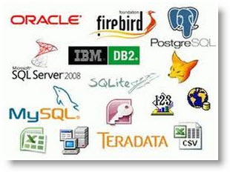
Introduction to Relational Database and SQL

Slide 2
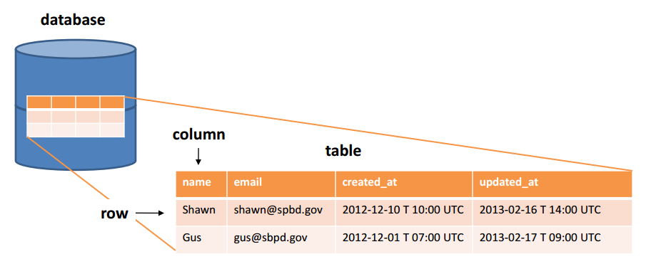

Slide 3
What is RDBMS?
A relational database organizes data in tables. A table has rows (or records) and columns (or fields).
Tables are related based on common columns to eliminate data redundancy and ensure data integrity.
Popular Relationship Database Management System (RDBMS) includes the commercial:
Oracle, IBM DB2, Microsoft SQL Server and Access, SAP Sybase and Teradata;
Free and open sourced
MySQL, MariaDB, PostgreSQL, Embedded Apache Derby (Java DB), mSQL (mini-SQL), SQLite and Apache OpenOffice's Base

Slide 4
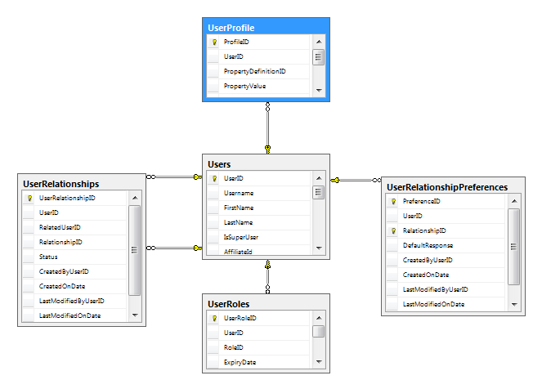
Why Relational Database?

Slide 5
What is Structure Query Language (SQL)?
A high-level language, called Structure Query Language (SQL), is
designed for interacting with the relational databases.
SQL defines a set of commands, such as SELECT, INSERT, UPDATE,
DELETE, CREATE TABLE, DROP TABLE, and etc.
Edgar F. Codd (of IBM) proposed the Relational Database Model in 1970. SQL, one of the earlier programming language, was subsequently developed by Donald D. Chamberlin and Raymond F. Boyce at IBM in the early 1970s. Oracle, subsequently, took it to a new height.
ANSI (American National Standard Institute) established the first SQL standard in 1986 (SQL-86 or SQL-87) - adopted by ISO/IEC as "ISO/IEC 9075" - followed in 1989 (SQL-89), 1992 (SQL-92 or SQL2), 1999 (SQL-99 or SQL3), 2003 (SQL-2003), 2006 (SQL-2006) and 2011 (SQL-2011). However, most of the database vendors have their own directs, e.g., PL/SQL (Oracle), Transact-SQL (Microsoft, SAP), PL/pgSQL (PostgreSQL).

Slide 6
Introduction to MySQL
SQL is a programming language for interacting with relational databases. On the other hand, MySQL is a software system - a Relational Database Management System.
MySQL is one of the most used, and possibly the best industrial-strength, open-source and free Relational Database Management System (RDBMS).
MySQL was developed by Michael "Monty" Widenius and David Axmark in 1995. It was owned by a Swedish company called MySQL AB, which was bought over by Sun Microsystems in 2008. Sun Microsystems was acquired by Oracle in 2010.
MySQL is successful, not only because it is free and open-source (there are many free and open-source databases, such as Apache Derby (Java DB), mSQL (mini SQL), SQLite, PostgreSQL and Apache OpenOffice's Base), but also for its speed, ease of use, reliability, performance, connectivity (full networking support), portability (run on most OSes, such as Unix, Windows, Mac), security (SSL support), small size, and rich features.
MySQL supports all features expected in a high-performance relational database, such as transactions, foreign key, replication, subqueries, stored procedures, views and triggers.
MySQL is often deployed in a LAMP (Linux-Apache-MySQL-PHP), WAMP (Windows-Apache-MySQL-PHP), or MAMP (Mac OS-Apache-MySQL-PHP) environment. All components in LAMP is free and open-source, inclusive of the Operating System.

Slide 7
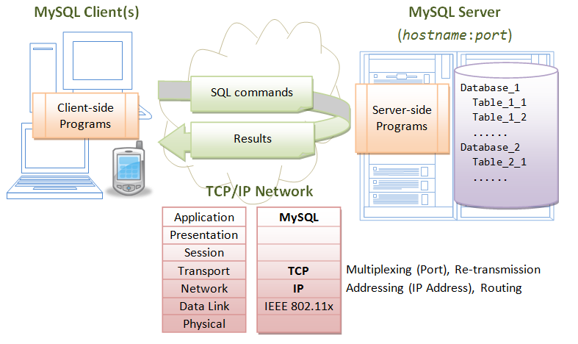

Slide 8
MySQL- Architecture
MySQL operates as a client-server system over TCP/IP network.
The server runs on a machine with an IP address, on a chosen TCP port number.
The default TCP port number for MySQL is 3306. Users can access the server via a client program, connecting to the server at the given IP address and TCP port number.
A MySQL database server contains one or more databases.
A database contains one or more tables.
A table consists of rows (or records) and columns (or fields).

Slide 9
Install MySQL 5.7 and SQL Programming
Step 0: Create a directory to keep all your works
Create a directory called "c:\mysql" (for Windows) to keep all your works.
// For Windows: Use "C:\mysql“
// Launch a “cmd" and issue these commands:
Microsoft Windows [Version 6.3.9600]
(c) 2013 Microsoft Corporation. All rights reserved.
C:\Users\test>cd \
C:\>
C:\>mkdir mysql
C:\>cd mysql
C:\mysql>

Slide 10
Step 1: Download and Install MySQL (For Windows)
Download MySQL ZIP ARCHIVE from https://dev.mysql.com/downloads/mysql/
Choose "General Available (GA) Releases" tab.
Under "MySQL Community Server 5.7.xx" ⇒ In "Select Platform", choose "Microsoft Windows".
Under "Other Downloads", download "Windows (x86, 64-bit), ZIP ARCHIVE (mysql-5.7.xx-winx64.zip)“.
(You can check whether your Windows is 32-bit or 64-bit from "Control Panel" ⇒ System and Security (optional) ⇒ System ⇒ Under "System Type".
There is NO need to "Login" or "Sign up" - Just click "No thanks, just start my downloads!".
UNZIP the downloaded file into your project directory "C:\mysql".
MySQL will be unzipped as "c:\mysql\mysql-5.7.{xx}-winx64".
For EASE OF USE, we shall shorten and rename the directory to "c:\mysql\mysql".
Take note and remember your MySQL installed directory!!!
(NEW since MySQL 5.7.7) Initialize the database: Start a CMD (as administrator) ("Search" button ⇒ Enter "cmd" ⇒ Right-Click ⇒ Run as Administrator) and issue these commands:

Slide 11
Step 02
// Change directory to the MySQL's binary directory
// Suppose that your MySQL is installed in "c:\mysql"
C:\mysql>cd mysql-5.7.21-winx64
C:\mysql\mysql-5.7.21-winx64>cd bin
// Initialize the database.
// Create a root user with random password.
// Show the messages on console
mysqld --initialize --console
......
......
[Note] A temporary password is generated for root@localhost: xxxxxxxx
During the installation, a superuser called root is created with a temporary password, as shown above.
TAKE NOTE of the PASSWORD, COPY and save it somewhere, or better still TAKE A PICTURE!!!!
If you make a mistake somewhere or forgot your password, DELETE the entire MySQL directory " C:\mysql\mysql-5.7.21-winx64", and REPEAT step 2 and 3.

Slide 12
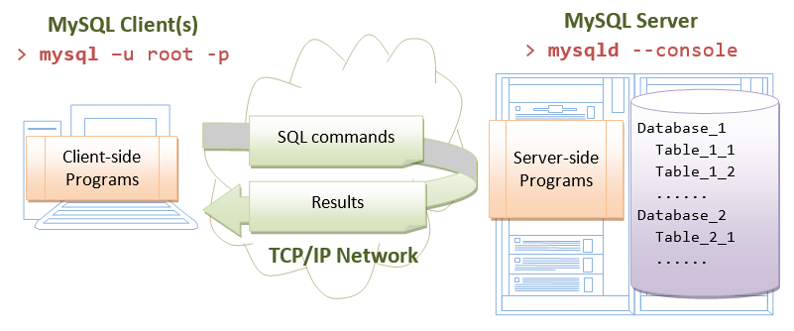
Step 3: Start the "Server"
The MySQL is a client-server system.
The database is run as a server application.
Users access the database server via a client program, locally or remotely thru the network, as illustrated:

Slide 13
The server program is called "mysqld" (with a suffix 'd', which stands for daemon - a daemon is a non-interactive process running in the background).
The client program is called "mysql" (without the 'd').
The programs mysqld and mysql are kept in the "bin" sub-directory of the MySQL installed directory.
Startup Server (For Windows)
To start the database server, launch a new CMD shell:
-- Change the current directory to MySQL's binary directory
-- Assume that the MySQL installed directory is "c:\myWebProject\mysql"
c: cd \mysql\mysql\bin
-- Start the MySQL Database Server
mysqld --console
......
......
XXXXXX XX:XX:XX [Note] mysqld: ready for connections.
Version: '5.7.xx' socket: '' port: 3306 MySQL Community Server (GPL)
Notes: The --console option directs the output messages to the console. Without this option, you will see a blank screen.

Slide 14
Shutdown Server (For Windows)
The quickest way to shut down the database server is to press Ctrl-C to initiate a normal shutdown.
DO NOT KILL the server via the window's CLOSE button.
Observe these messages from the MySQL server console:
XXXXXX XX:XX:XX [Note] mysqld: Normal shutdown
......
XXXXXX XX:XX:XX InnoDB: Starting shutdown...
XXXXXX XX:XX:XX InnoDB: Shutdown completed; log sequence number 0 44233
......
XXXXXX XX:XX:XX [Note] mysqld: Shutdown complete

Slide 15
Step 4: Start a "Client"
Recall that the MySQL is a client-server system. Once the server is started, one or more clients can be connected to the database server. A client could be run on the same machine (local client); or from another machine over the network (remote client).
To login to the MySQL server, you need to provide a username and password. During the installation, MySQL creates a superuser called "root" with a temporary password.
The MySQL installation provides a command-line client program called "mysql". (Recall that the server program is called "mysqld" with a suffix 'd'; the client program does not have the suffix 'd').
Let's start a command-line client with the superuser "root".
First, make sure that the server is running. See previous step to re-start the server if it has been shutdown.

Slide 16
For Windows
Start Another NEW CMD shell to run the client (You need to keep the CMD that run the server):
-- Change the current directory to MySQL's binary directory.
-- Assume that the MySQL is installed in "c:\mysql\mysql".
c: cd \mysql\mysql\bin
-- Start a client as superuser "root" (-u), and prompt for password (-p)
mysql -u root -p
Enter password: // Enter the root's password set during installation.
Welcome to the MySQL monitor. Commands end with ; or \g.
Your MySQL connection id is 1
Server version: 5.7.21
Type 'help;' or '\h' for help. Type '\c' to clear the current input statement.
mysql>
-- Client started. The prompt changes to "mysql>".
-- You can now issue SQL commands such as SELECT, INSERT and DELETE.

Slide 17
Step 5: Change the Password for the Superuser "root"
As mentioned earlier, the MySQL installation creates a superuser called "root" with a temporary random password. "root" is a privileged user that can do anything, including deleting all the databases. You are required to change the root's password immediately after logging in.
Changing the Password for "root"
Let's continue with our client session started earlier.
-- Change password for 'root'@'localhost'. Replace xxxx with your chosen password
-- (For my students: use xxxx as the password. Otherwise, you will ask me what is your password next week.)
-- Take note that strings are to be enclosed by a pair of single-quotes.
mysql> alter user 'root'@'localhost' identified by 'xxxx';
Query OK, 0 rows affected (0.00 sec)
-- logout and terminate the client program
mysql> quit
Bye

Slide 18
Re-Start a Client as "root" with the New Password
We have just changed the password for root and exited the client. Start a client and login as root again. Enter the password when prompted.
For Windows
-- Change directory to MySQL's binary directory
c:
cd \mysql\mysql\bin
-- Start a MySQL client
mysql -u root -p
Enter password: // Enter the NEW password
Welcome to the MySQL monitor.
......
mysql>
-- client started, ready to issue SQL command

Slide 19
Step 6: Create a New User
The superuser "root" is privileged, which is meant for database administration and is not meant for operational. We shall create a new user - let's call it "myuser" - with a lesser privilege. To create a new user, start a client with superuser "root":
-- Start a client, IF IT IS NOT STARTED
mysql -u root -p // Windows
-- Create a new user called "myuser", which can login from localhost, with password "xxxx"
mysql> create user 'myuser'@'localhost' identified by 'xxxx';
Query OK (0.01 sec)
-- Grant permission to myuser to perform tasks
mysql> grant all on *.* to 'myuser'@'localhost';
Query OK (0.01 sec)
mysql> quit

Slide 20
CREATE USER 'myuser'@'localhost' IDENTIFIED BY 'xxxx'
We use the command "create user" to create a new user called 'myuser'@'localhost', who can login to the server locally from the same machine (but not remotely from another machine), with password "xxxx".
GRANT ALL ON *.* TO 'myuser'@'localhost'
The newly created user has NO privilege to perform any database operation including select. We use the "grant" command to grant "all" the privileges (including select, insert, delete, and so on) to this new user on ALL the databases and ALL the tables ("on *.*"). This new user, in practice, has the same privilege as root, except that it cannot issue grant command. For production, you should grant only the necessary privileges on selected databases and selected tables, e.g., "grant select, insert, update on studentdb.*" - it can issue select, insert and update (but no delete, create/drop table) on ALL the tables of the database studentdb only.

Slide 21
C:\mysql\mysql-5.7.21-winx64\bin>mysql -u root -p
Enter password: ****
Welcome to the MySQL monitor. Commands end with ; or \g.
Your MySQL connection id is 19
Server version: 5.7.21 MySQL Community Server (GPL)
Copyright (c) 2000, 2018, Oracle and/or its affiliates. All rights reserved.
Oracle is a registered trademark of Oracle Corporation and/or its
affiliates. Other names may be trademarks of their respective
owners.
Type 'help;' or '\h' for help. Type '\c' to clear the current input statement.
mysql> GRANT ALL PRIVILEGES ON *.* TO 'myuser'@'localhost' IDENTIFIED BY 'gopi‘ WITH GRANT OPTION;
Query OK, 0 rows affected, 1 warning (0.03 sec)
mysql> QUIT
Bye

Slide 22
Step 6; Install MySQL JDBC Driver.
You need to install an appropriate JDBC (Java Database Connectivity) driver to run your Java database programs.
The MySQL's JDBC driver is called "MySQL Connector/J" and is available at MySQL mother site.
For Windows
Download the "latest" MySQL JDBC driver from http://dev.mysql.com/downloads ⇒ "MySQL Connectors" ⇒ "Connector/J" ⇒ Connector/J 5.1.{xx} ⇒ select "Platform Independent" ⇒ ZIP Archive (e.g., "mysql-connector-java-5.1.{xx}.zip", where {xx} is the latest release number) ⇒ "No thanks, just start my download".
UNZIP the download file into your project directory "C:\mysql\".
Open the unzipped folder. Check for JAR file "mysql-connector-java-5.1.{xx}-bin.jar". The absolute filename of the JAR file (which you will need later) is "C:\myWebProject\mysql-connector-java-5.1.{xx}\mysql-connector-java-5.1.{xx}-bin.jar". Take note of this super-long filename that you will need later. COPY and SAVE in a scratch pad so that you can retrieve later.

Slide 23
What is JDBC?
JDBC stands for Java Database Connectivity, which is a standard Java API for database-independent connectivity between the Java programming language and a wide range of databases.
The JDBC library includes APIs for each of the tasks mentioned below that are commonly associated with database usage.
  Making a connection to a database.
  Creating SQL or MySQL statements.
  Executing SQL or MySQL queries in the database.
  Viewing & Modifying the resulting records.
Fundamentally, JDBC is a specification that provides a complete set of interfaces that allows for portable access to an underlying database.
All of Java application are able to use a JDBC driver to access a database, and take advantage of the stored data.
JDBC provides the same capabilities as ODBC, allowing Java programs to contain database-independent code.

Slide 24
JDBC Architecture
The JDBC API supports both two-tier and three-tier processing models for database access but in general, JDBC Architecture consists of two layers −
JDBC API: This provides the application-to-JDBC Manager connection.
JDBC Driver API: This supports the JDBC Manager-to-Driver Connection.
The JDBC API uses a driver manager and database-specific drivers to provide transparent connectivity to heterogeneous databases.
The JDBC driver manager ensures that the correct driver is used to access each data source. The driver manager is capable of supporting multiple concurrent drivers connected to multiple heterogeneous databases.
Following is the architectural diagram, which shows the location of the driver manager with respect to the JDBC drivers and the Java application −

Slide 25
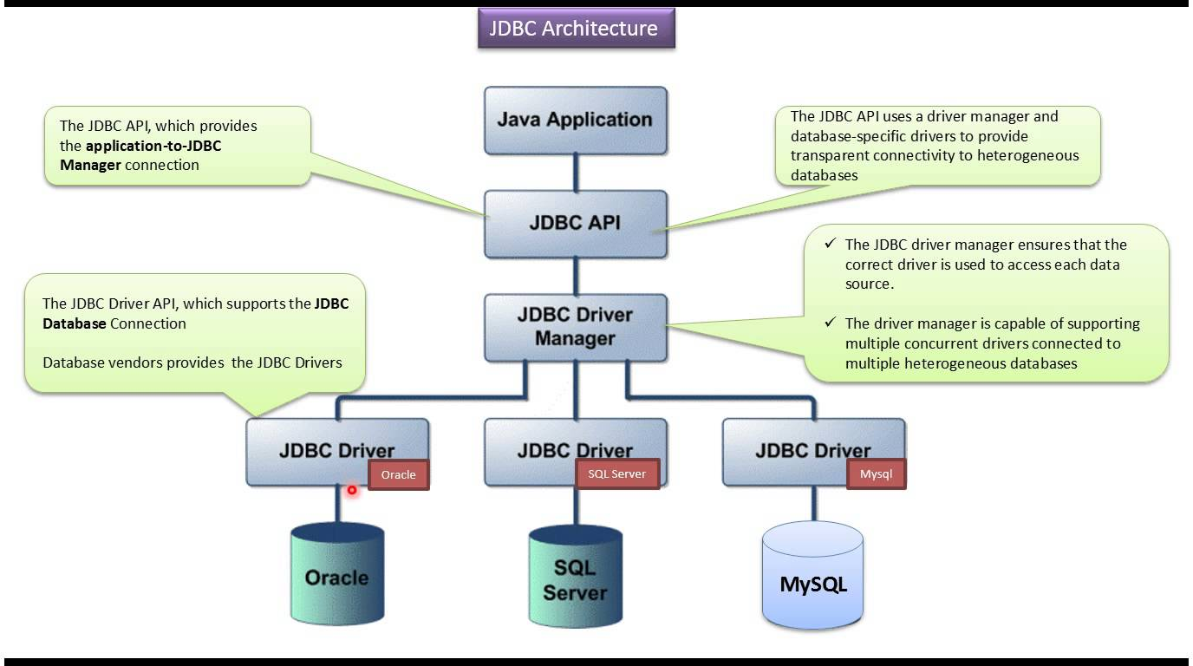

Slide 26
Common JDBC Components
The JDBC API provides the following interfaces and classes −
DriverManager: This class manages a list of database drivers. Matches connection requests from the java application with the proper database driver using communication sub protocol. The first driver that recognizes a certain sub protocol under JDBC will be used to establish a database Connection.
Driver: This interface handles the communications with the database server. You will interact directly with Driver objects very rarely. Instead, you use DriverManager objects, which manages objects of this type. It also abstracts the details associated with working with Driver objects.
Connection: This interface with all methods for contacting a database. The connection object represents communication context, i.e., all communication with database is through connection object only.
Statement: You use objects created from this interface to submit the SQL statements to the database. Some derived interfaces accept parameters in addition to executing stored procedures.
ResultSet: These objects hold data retrieved from a database after you execute an SQL query using Statement objects. It acts as an iterator to allow you to move through its data.
SQLException: This class handles any errors that occur in a database application.

Slide 27
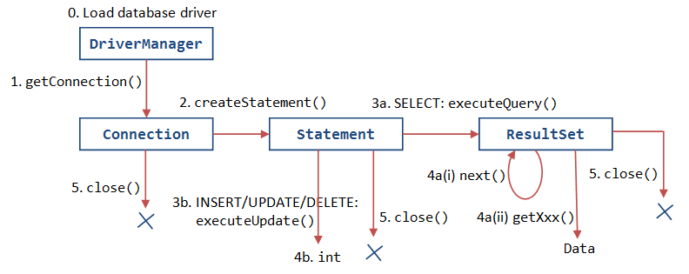
JDBC- Life Cycle

Slide 28
The JDBC 4.0 Packages
The java.sql and javax.sql are the primary packages for JDBC 4.0.
This is the latest JDBC version at the time of writing this tutorial.
It offers the main classes for interacting with your data sources.
The new features in these packages include changes in the following areas −
Automatic database driver loading.
Exception handling improvements.
Enhanced BLOB/CLOB functionality.
Connection and statement interface enhancements.
National character set support.
SQL ROWID access.
SQL 2003 XML data type support.
Annotations.

Slide 29
SQL Syntax
Structured Query Language (SQL) is a standardized language that allows you to perform operations on a database, such as creating entries, reading content, updating content, and deleting entries.
SQL is supported by almost any database you will likely use, and it allows you to write database code independently of the underlying database.
Create, Create, Read, Update, and Delete (often referred to as CRUD operations) data from a database:
Exercises:
JDBC_Exercises.docx

Slide 30
JDBC - Create Database
You should have admin privilege to create a database in the given schema. To execute the following example, you need to replace the username and password with your actual user name and password.
Your MySQL or whatever database you are using, is up and running.
Required Steps : to create a new Database using JDBC application
Import the packages: Requires that you include the packages containing the JDBC classes needed for database programming. Most often, using import java.sql.* will suffice.
Register the JDBC driver: Requires that you initialize a driver so you can open a communications channel with the database.
Open a connection: Requires using the DriverManager.getConnection() method to create a Connection object, which represents a physical connection with the database server.
To create a new database, you need not give any database name while preparing database URL as mentioned in the below example.
Execute a query: Requires using an object of type Statement for building and submitting an SQL statement to the database.
Clean up the environment . Requires explicitly closing all database resources versus relying on the JVM's garbage collection.
JDBCConnect.java

Slide 31
JDBC – Connect to a Database
Required Steps
The following steps are required to create a new Database using JDBC application.
Import the packages: Requires that you include the packages containing the JDBC classes needed for the database programming. Most often, using import java.sql.* will suffice.
Register the JDBC driver: Requires that you initialize a driver so you can open a communications channel with the database.
Open a connection: Requires using the DriverManager.getConnection() method to create a Connection object, which represents a physical connection with a selected database.
Selection of database is made while you prepare database URL. Following example would make connection with emp database.
Clean up the environment: Requires explicitly closing all the database resources versus relying on the JVM's garbage collection.
JDBCConnect.java

Slide 32
JDBC – Drop a Database
Required Steps
The following steps are required to drop a new Database using JDBC application.
Import the packages: Requires that you include the packages containing the JDBC classes needed for the database programming. Most often, using import java.sql.* will suffice.
Register the JDBC driver: Requires that you initialize a driver so you can open a communications channel with the database.
Open a connection: Requires using the DriverManager.getConnection() method to create a Connection object, which represents a physical connection with a selected database.
Selection of database is made while you prepare database URL. Following example would make connection with emp database.
Clean up the environment: Requires explicitly closing all the database resources versus relying on the JVM's garbage collection.
JDBCDropDB.java

Slide 33
JDBC – Create Table
Required Steps
The following steps are required to create a table in emp database using JDBC application.
Import the packages: Requires that you include the packages containing the JDBC classes needed for the database programming. Most often, using import java.sql.* will suffice.
Register the JDBC driver: Requires that you initialize a driver so you can open a communications channel with the database.
Open a connection: Requires using the DriverManager.getConnection() method to create a Connection object, which represents a physical connection with a selected database.
Selection of database is made while you prepare database URL. Following example would make connection with emp database.
Clean up the environment: Requires explicitly closing all the database resources versus relying on the JVM's garbage collection.
JDBCCreateTable.java

Slide 34
JDBC – Delete a Table
Required Steps
The following steps are required how to delete a table using JDBC application.
Import the packages: Requires that you include the packages containing the JDBC classes needed for the database programming. Most often, using import java.sql.* will suffice.
Register the JDBC driver: Requires that you initialize a driver so you can open a communications channel with the database.
Open a connection: Requires using the DriverManager.getConnection() method to create a Connection object, which represents a physical connection with a selected database.
Selection of database is made while you prepare database URL. Following example would make connection with emp database.
Clean up the environment: Requires explicitly closing all the database resources versus relying on the JVM's garbage collection.
JDBCDeleteTable.java

Slide 35
JDBC – Insert Records into a Table
Required Steps
The following steps are required how to insert records in a table using JDBC application.
Import the packages: Requires that you include the packages containing the JDBC classes needed for the database programming. Most often, using import java.sql.* will suffice.
Register the JDBC driver: Requires that you initialize a driver so you can open a communications channel with the database.
Open a connection: Requires using the DriverManager.getConnection() method to create a Connection object, which represents a physical connection with a selected database.
Selection of database is made while you prepare database URL. Following example would make connection with emp database.
Clean up the environment: Requires explicitly closing all the database resources versus relying on the JVM's garbage collection.
JDBCInsertRecords.java

Slide 36
JDBC – Select Records from Table
Required Steps
The following steps are required how to select / fetch records from a table using JDBC application.
Import the packages: Requires that you include the packages containing the JDBC classes needed for the database programming. Most often, using import java.sql.* will suffice.
Register the JDBC driver: Requires that you initialize a driver so you can open a communications channel with the database.
Open a connection: Requires using the DriverManager.getConnection() method to create a Connection object, which represents a physical connection with a selected database.
Selection of database is made while you prepare database URL. Following example would make connection with emp database.
Clean up the environment: Requires explicitly closing all the database resources versus relying on the JVM's garbage collection.
JDBCSelectRecords.java

Slide 37
JDBC – Update Records
Required Steps
The following steps are required how to update records in a table using JDBC application.
Import the packages: Requires that you include the packages containing the JDBC classes needed for the database programming. Most often, using import java.sql.* will suffice.
Register the JDBC driver: Requires that you initialize a driver so you can open a communications channel with the database.
Open a connection: Requires using the DriverManager.getConnection() method to create a Connection object, which represents a physical connection with a selected database.
Selection of database is made while you prepare database URL. Following example would make connection with emp database.
Clean up the environment: Requires explicitly closing all the database resources versus relying on the JVM's garbage collection.
JDBCUpdateRecords.java

Slide 38
JDBC – Delete Records
Required Steps
The following steps are required how to delete records in a table using JDBC application.
Import the packages: Requires that you include the packages containing the JDBC classes needed for the database programming. Most often, using import java.sql.* will suffice.
Register the JDBC driver: Requires that you initialize a driver so you can open a communications channel with the database.
Open a connection: Requires using the DriverManager.getConnection() method to create a Connection object, which represents a physical connection with a selected database.
Selection of database is made while you prepare database URL. Following example would make connection with emp database.
Clean up the environment: Requires explicitly closing all the database resources versus relying on the JVM's garbage collection.
JDBCDeleteRecords.java

Slide 39
JDBC – Select with WHERE clause
Required Steps
The following steps are required how to select records from a table using JDBC application. This would add additional conditions using WHERE clause while selecting records from the table.
Import the packages: Requires that you include the packages containing the JDBC classes needed for the database programming. Most often, using import java.sql.* will suffice.
Register the JDBC driver: Requires that you initialize a driver so you can open a communications channel with the database.
Open a connection: Requires using the DriverManager.getConnection() method to create a Connection object, which represents a physical connection with a selected database.
Selection of database is made while you prepare database URL. Following example would make connection with emp database.
Clean up the environment: Requires explicitly closing all the database resources versus relying on the JVM's garbage collection.
JDBCSelectRecordsWithWHERE.java

Slide 40
JDBC – Select with Like clause
Required Steps
The following steps are required how to select records from a table using JDBC application. This would add additional conditions using LIKE clause while selecting records from the table.
Import the packages: Requires that you include the packages containing the JDBC classes needed for the database programming. Most often, using import java.sql.* will suffice.
Register the JDBC driver: Requires that you initialize a driver so you can open a communications channel with the database.
Open a connection: Requires using the DriverManager.getConnection() method to create a Connection object, which represents a physical connection with a selected database.
Selection of database is made while you prepare database URL. Following example would make connection with emp database.
Clean up the environment: Requires explicitly closing all the database resources versus relying on the JVM's garbage collection.
JDBCSelectRecordsWithLIKE.java

Slide 41
JDBC – Sort Records
Required Steps
The following steps are required how to sort records from a table using JDBC application. This would add additional conditions using LIKE clause while selecting records from the table.
Import the packages: Requires that you include the packages containing the JDBC classes needed for the database programming. Most often, using import java.sql.* will suffice.
Register the JDBC driver: Requires that you initialize a driver so you can open a communications channel with the database.
Open a connection: Requires using the DriverManager.getConnection() method to create a Connection object, which represents a physical connection with a selected database.
Selection of database is made while you prepare database URL. Following example would make connection with emp database.
Clean up the environment: Requires explicitly closing all the database resources versus relying on the JVM's garbage collection.
JDBCSortRecords.java

